Slide 1


Understanding C++ Pointers
By Wakeland Branz
Mr. Flannery’s CSC134 CCCC Class

Slide 2
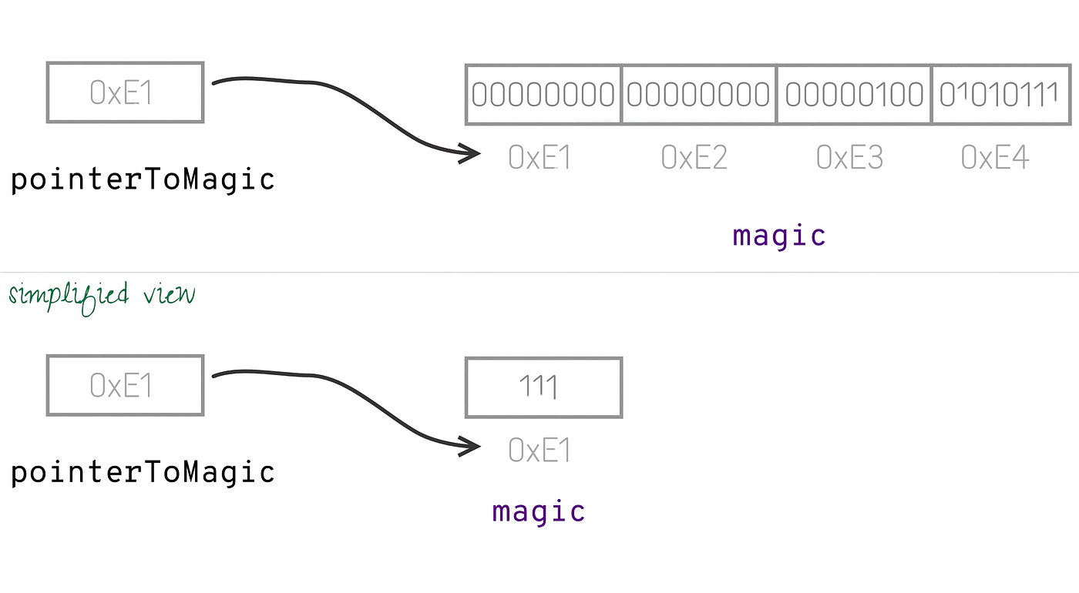
Introduction
Pointers are one of the most powerful yet challenging concepts in C++. They allow direct memory manipulation and provide the foundation for dynamic memory allocation, efficient array handling, and advanced data structures. Let's explore them step by step.

Slide 3
Memory and Addresses
Every variable in your program occupies space in the computer's memory. Each memory location has a unique address, like a house number on a street. When we work with pointers, we're working with these memory addresses.
Video with Visualization: https://www.youtube.com/watch?v=zaittayn5hw

Slide 4
Basic Example
int number = 42;
int* ptr = &number; // ptr stores the memory address of number
std::cout << "Value of number: " << number << std::endl;
std::cout << "Address of number: " << &number << std::endl;
std::cout << "Value stored in ptr: " << ptr << std::endl;
std::cout << "Value ptr points to: " << *ptr << std::endl;

Slide 5
Pointer Declaration and Initialization
When declaring pointers, the asterisk (*) tells the compiler we want a pointer variable. The type before the asterisk indicates what kind of data the pointer will point to:
int* intPtr; // Points to an integer
double* doublePtr; // Points to a double
char* charPtr; // Points to a character
// Best practice: Initialize pointers to nullptr if not
// assigning immediately
int* safePtr = nullptr;

Slide 6
Pointer Operations
Dereferencing: The * operator when used with a pointer is called the dereference operator. It gives us access to the value at the memory address:
int value = 100;
int* ptr = &value;
// Dereferences ptr which contains the address of value
*ptr = 200; // Changes the value of 'value' to 200
// Prints 200
std::cout << "New value: " << value << std::endl;

Slide 7
Common Applications
Dynamic Memory Allocation: Pointers are essential for dynamic memory allocation using new and delete:
// Single variable
int* dynamicInt = new int;
*dynamicInt = 42;
delete dynamicInt; // Don't forget to free the memory!
// Array
int* dynamicArray = new int[5];
for(int i = 0; i < 5; i++) {
dynamicArray[i] = i * 10;
}
delete[] dynamicArray; // Array deletion

Slide 8
Common Pitfalls and Best Practices
Always initialize pointers
Check for nullptr before dereferencing
Clean up dynamic memory
Be careful with pointer arithmetic
Use smart pointers in modern C++ when possible
The next slide contains a demonstrative example combining these practices

Slide 9
Common Pitfalls and Best Practices Cont.
int* createAndInitialize(int value) {
int* ptr = nullptr; // Good practice: initialize to nullptr
try {
ptr = new int; // Allocate memory
*ptr = value; // Initialize
if(*ptr < 0) { // Example validation
delete ptr;
return nullptr;
}
return ptr;
}
catch(std::bad_alloc& ba) {
return nullptr; // Handle allocation failure
}
}

